Slide 1

Module 3
Multiple Linear Regression
Notes:
Guidelines
Use section headers to chunk content in your presentation.
Use the same style of section header throughout your presentation.
Keep your title to no more than 2 lines.

Slide 2
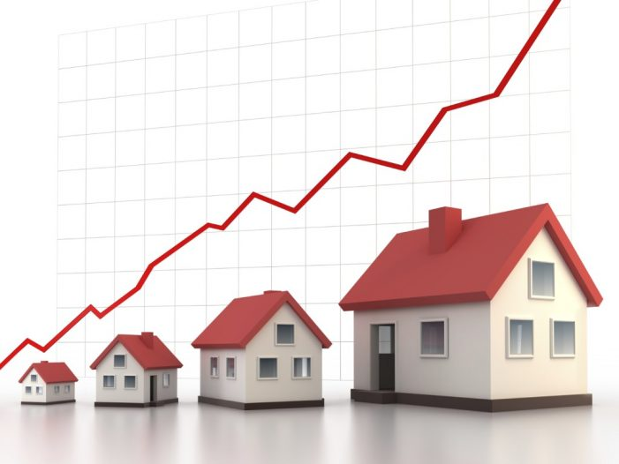
Home Market Values
Notes:
Guidelines
Use a title slide at the beginning of your presentation. There are 9 variations of title slides to choose from.
If you will have a series of slideshows, we recommend using the same style of title slide for each presentation.
Keep your title to no more than 2 lines.
Do not change the font style or font size of the title or subtitle.

Slide 3
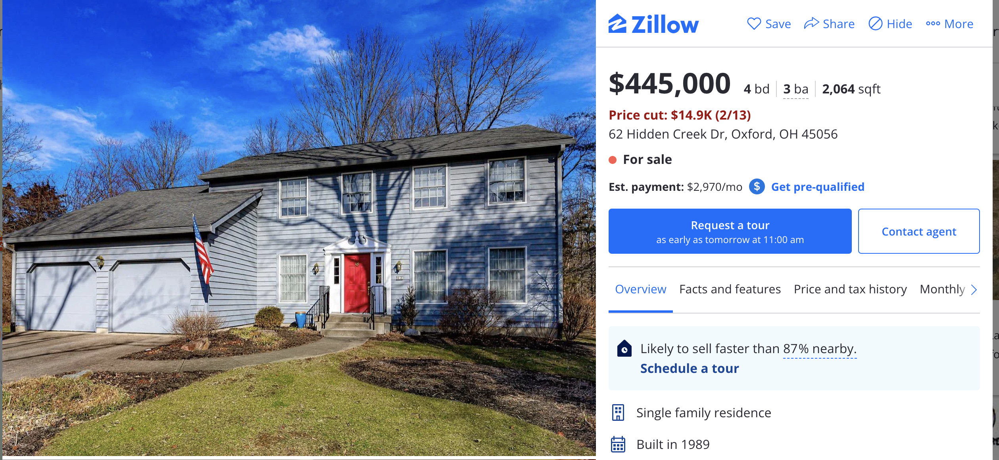
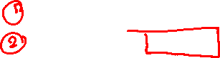
Goal
??????
House Age: 34 years
Square Footage: 2,064 sqft
Market Value: ????

Slide 4
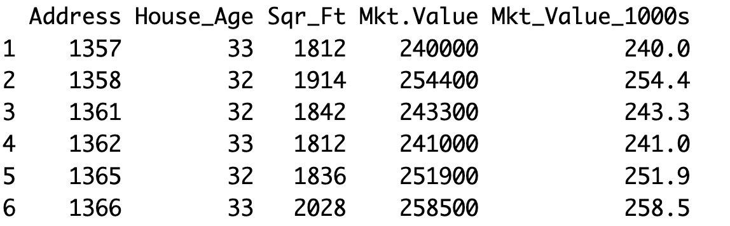
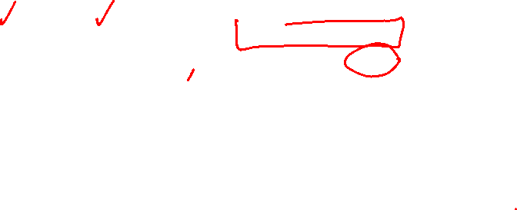
Data
Response: market value of homes in $1,000s
Predictors: house age (in years) and square footage (in feet)
X
y

Slide 5
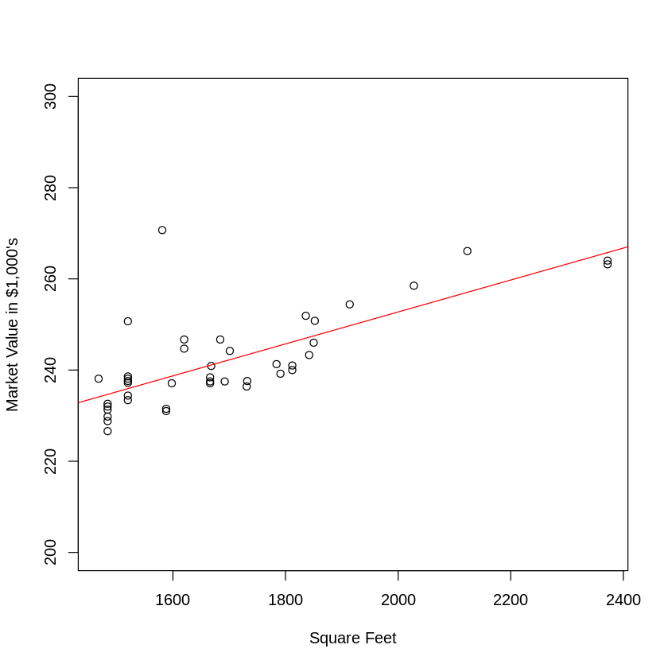
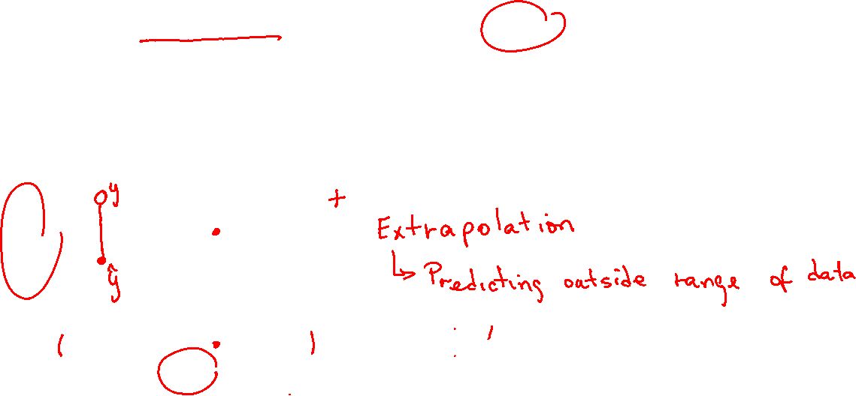
Data
Using simple linear regression does NOT take into account the joint relationships of variables

Slide 6
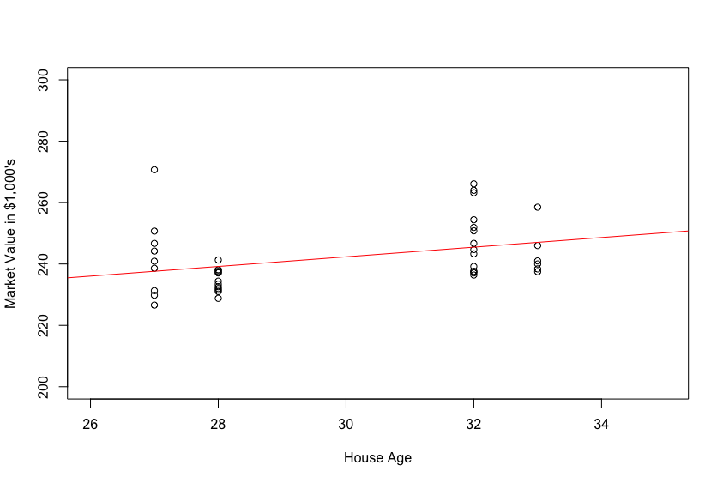
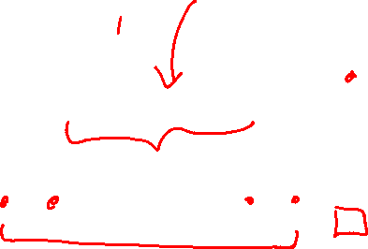
Data
Using simple linear regression does NOT take into account the joint relationships of variables
extrapolation

Slide 7
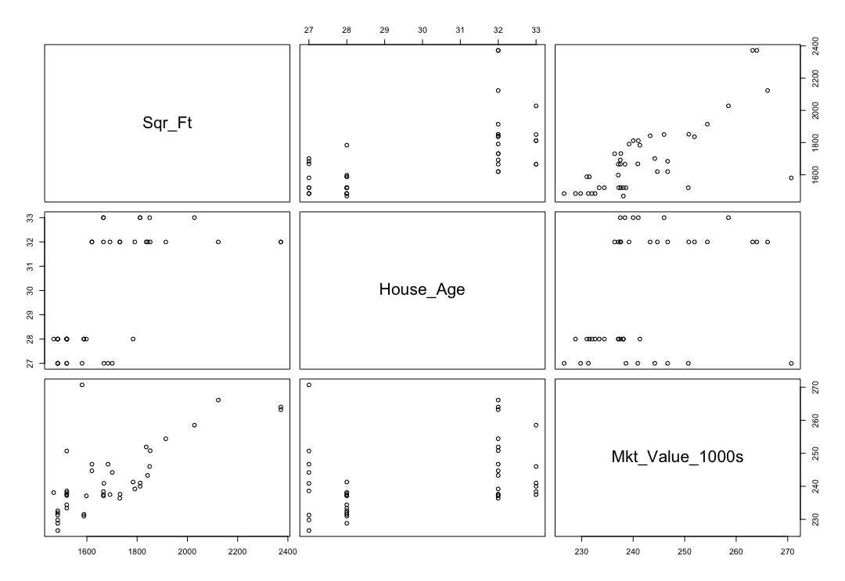
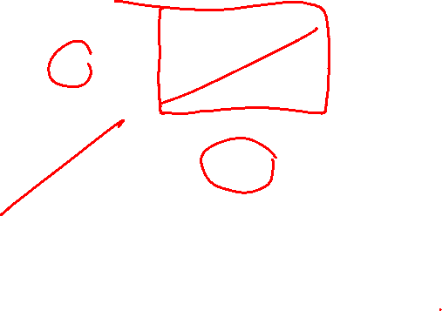
Scatter Plot Matrix
If two predictors bring redundant information to the model, the joint effect to predicting the response will not be as powerful

Slide 8
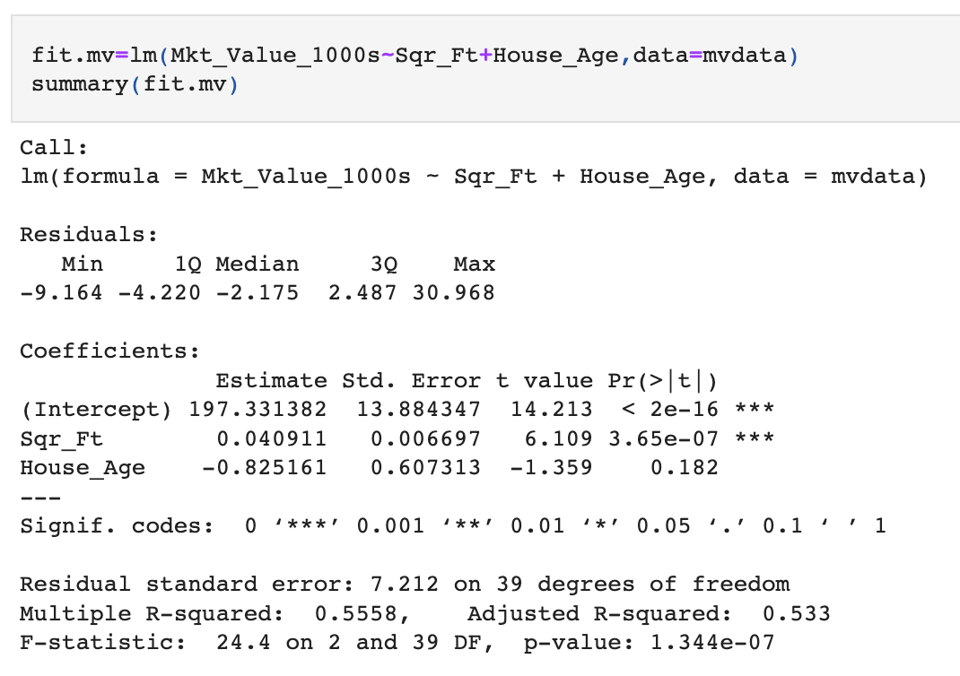
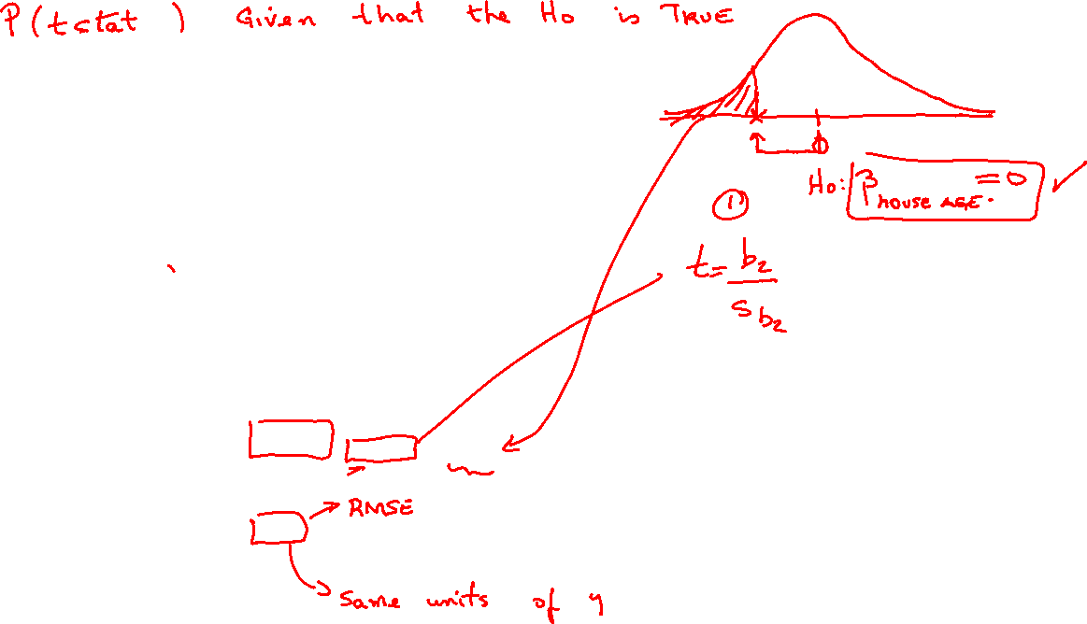
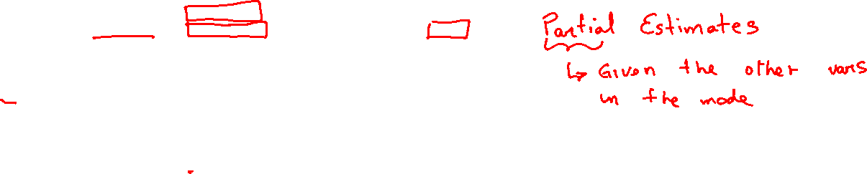
Estimates

Slide 9


Interpret the y-intercept in the language of the problem.
ⓘ Start presenting to display the poll results on this slide.

Slide 10
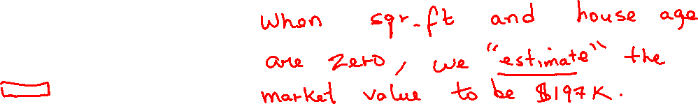
Interpretations

Slide 11
Interpret the slope for Square Footage in the language of the problem
ⓘ Start presenting to display the poll results on this slide.

Slide 12
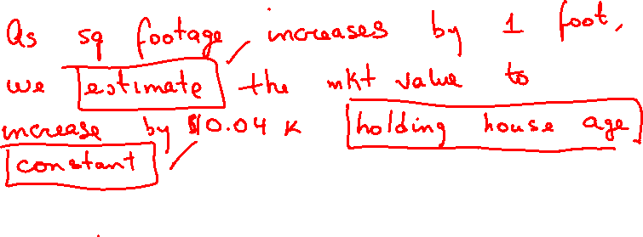
Interpretations

Slide 13
Interpret the slope of House Age in the language of the problem
ⓘ Start presenting to display the poll results on this slide.

Slide 14
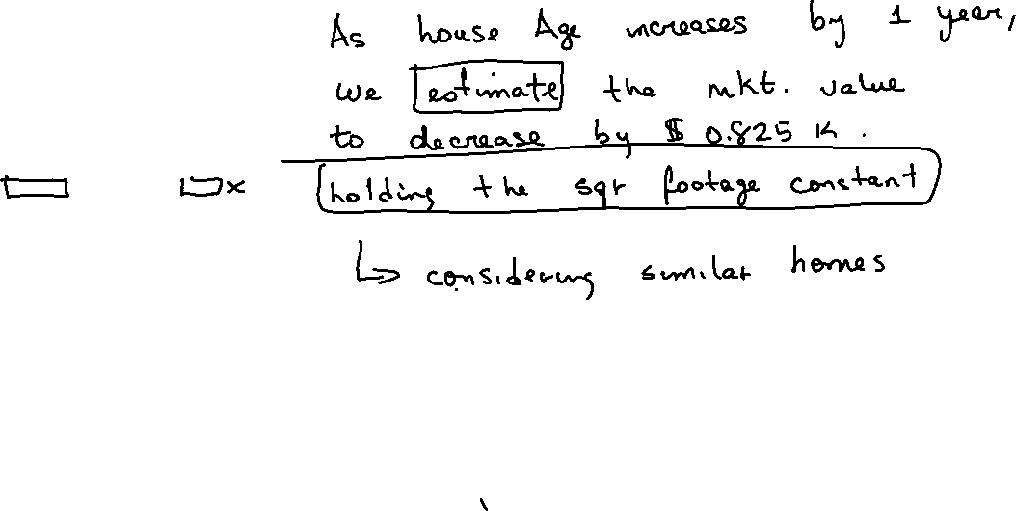
Interpretations

Slide 15

By how much do we expect the model to be off (estimated error in the prediction)?
ⓘ Start presenting to display the poll results on this slide.

Slide 16
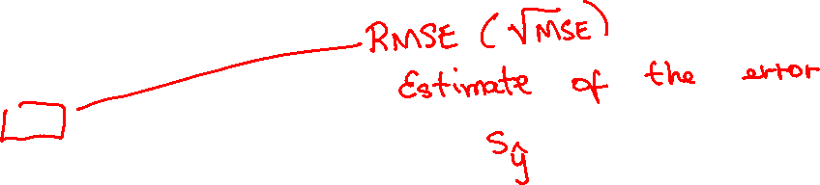
Goodness of Fit Metrics

Slide 17
What percentage of the variation in house prices can be explained by the model?
ⓘ Start presenting to display the poll results on this slide.

Slide 18
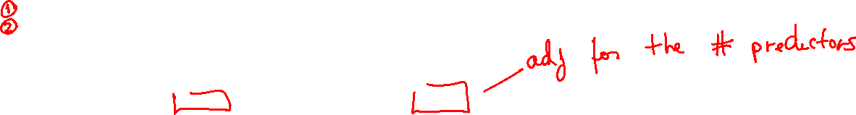
Goodness of Fit Metrics

Slide 19
What is SSE?
ⓘ Start presenting to display the poll results on this slide.

Slide 20
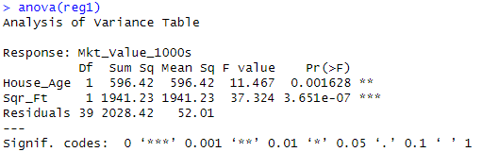
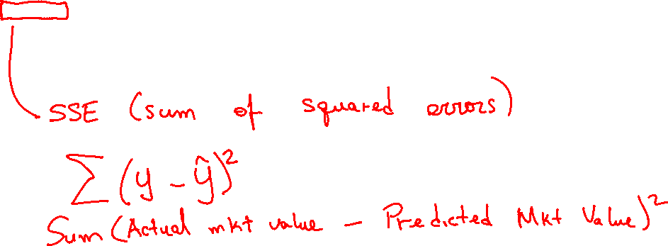
Goodness of Fit Metrics

Slide 21
What is the total SSR (Explained Variation)?
ⓘ Start presenting to display the poll results on this slide.

Slide 22
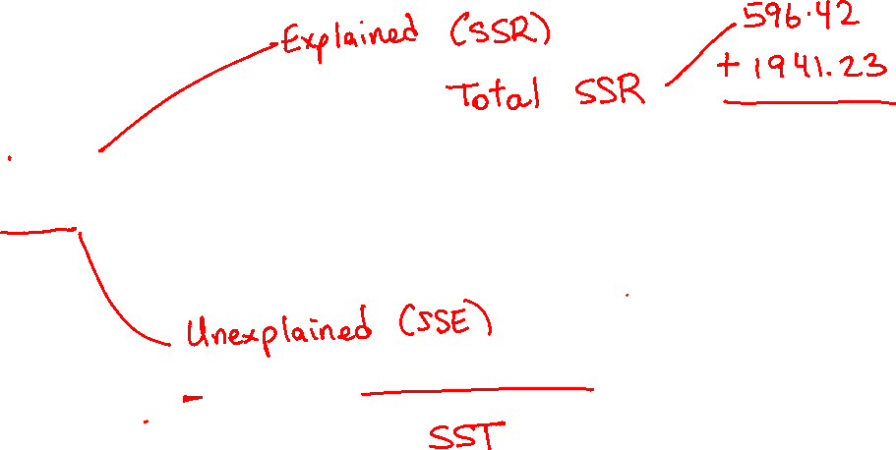
Goodness of Fit Metrics

Slide 23
What is the SSR contributed by House Age?
ⓘ Start presenting to display the poll results on this slide.

Slide 24
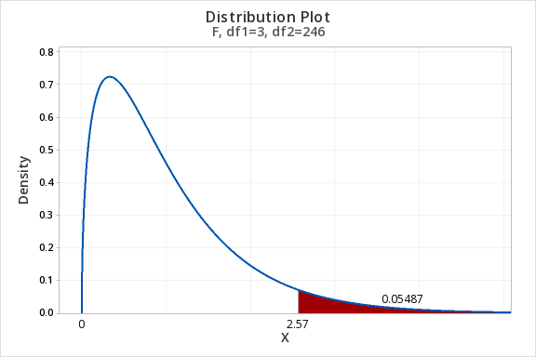
Overall Model Significance
Notes:
Guidelines
Use a title slide at the beginning of your presentation. There are 9 variations of title slides to choose from.
If you will have a series of slideshows, we recommend using the same style of title slide for each presentation.
Keep your title to no more than 2 lines.
Do not change the font style or font size of the title or subtitle.

Slide 25
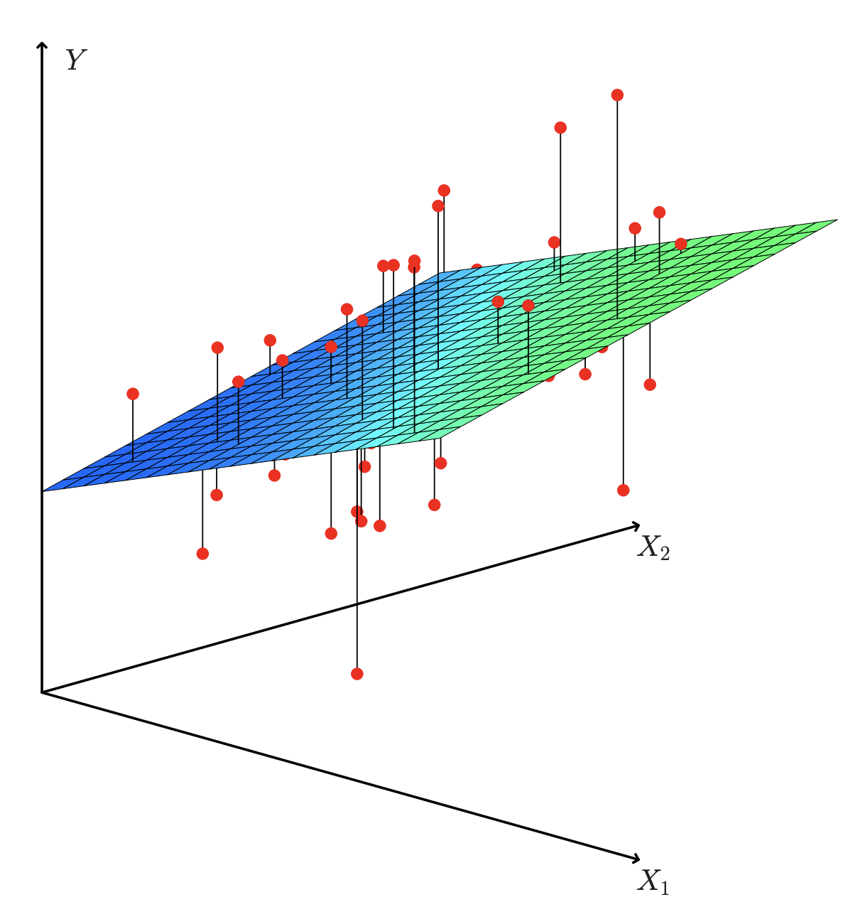
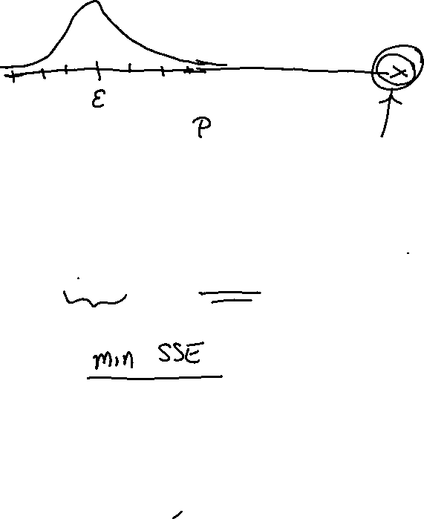
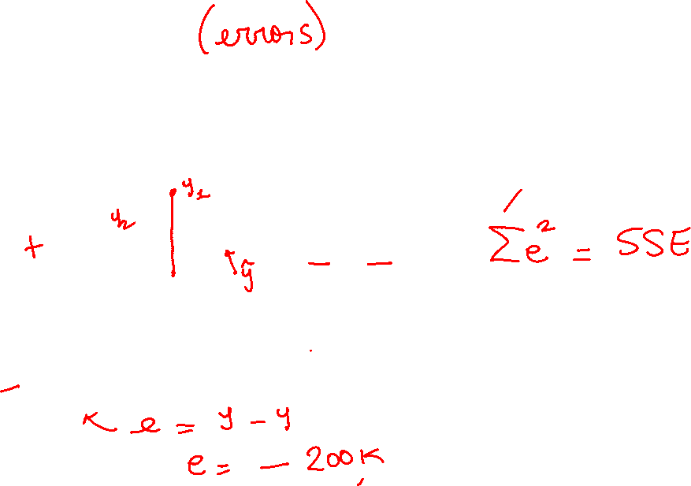
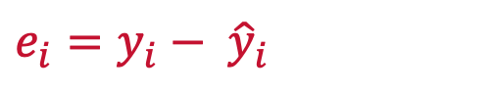
Residuals
These are the errors made by the model
Difference between the linear plane and the actual points
$$e_{i}=y_{i}− {\hat{y}}_{i}$$
Sq. Footage
House Age

Slide 26
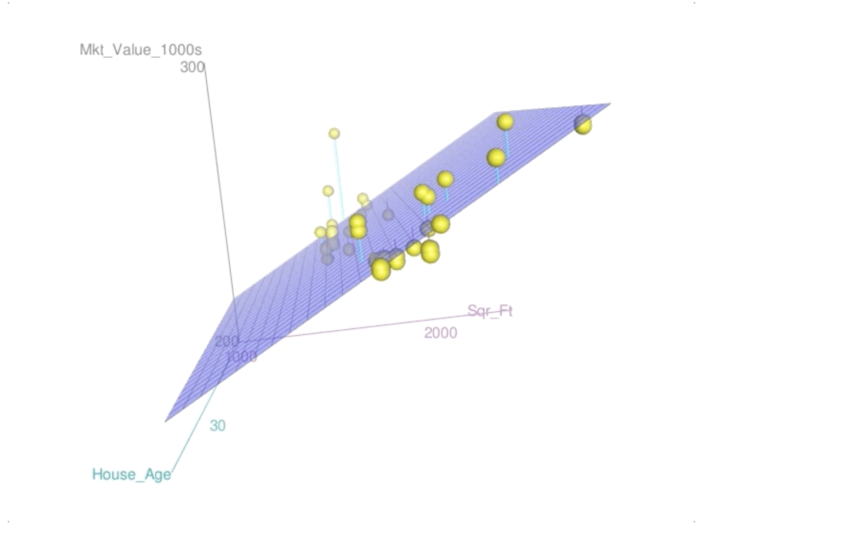
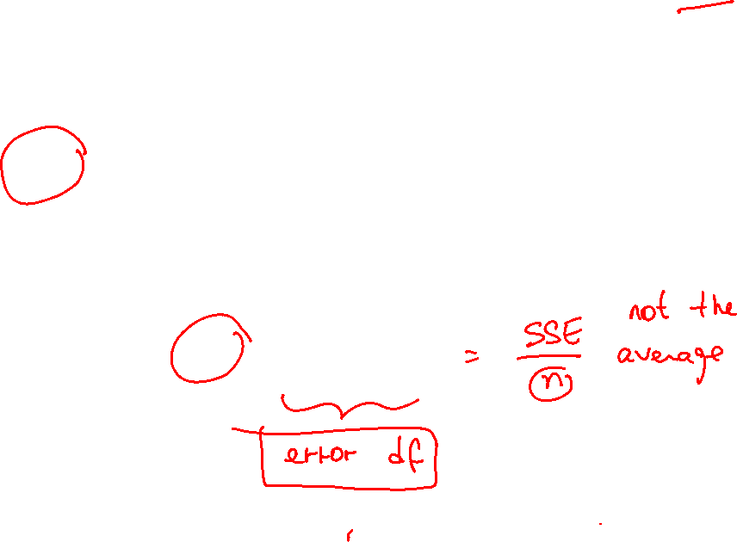
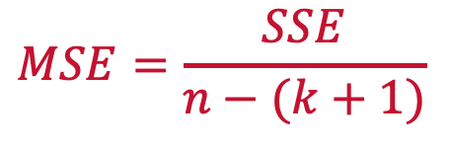

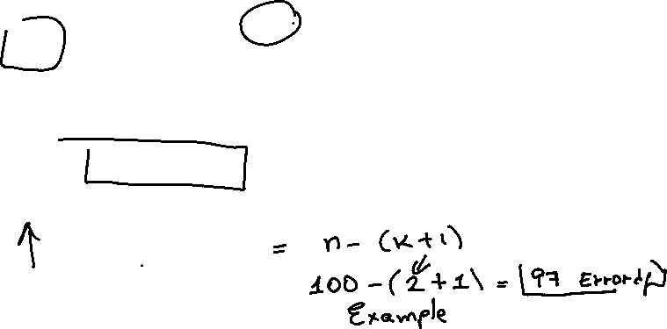
Variance Around Regression Plane
Estimated by the mean squared error (MSE)
The lower MSE, the better
$$MSE=\frac{SSE}{n−parameters estimated}$$
$$MSE=\frac{SSE}{n−(k+1)}$$

Slide 27
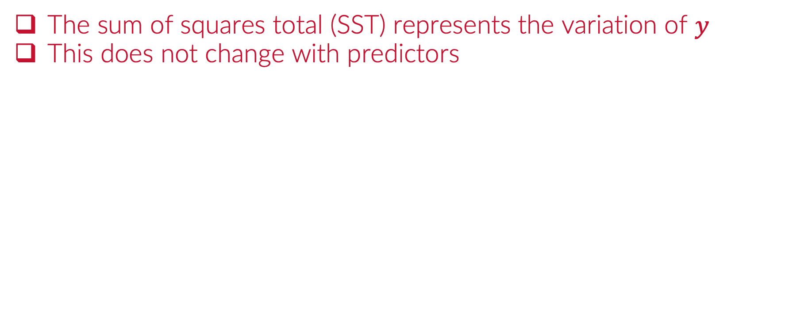
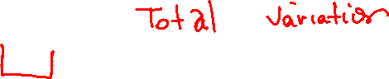
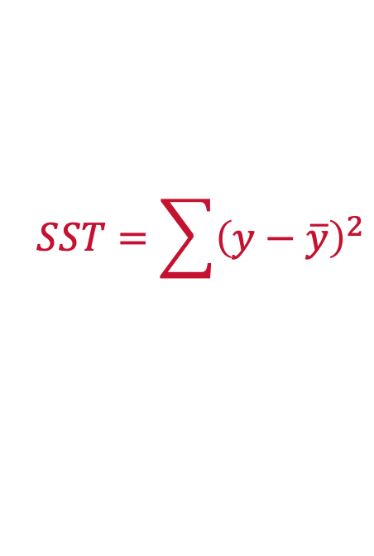
Total Variation (SST)
The sum of squares total (SST) represents the variation of $y$
This does not change with predictors
$$SST=\sum{{\left(y−\overline{y}\right)}^{2}}$$

Slide 28
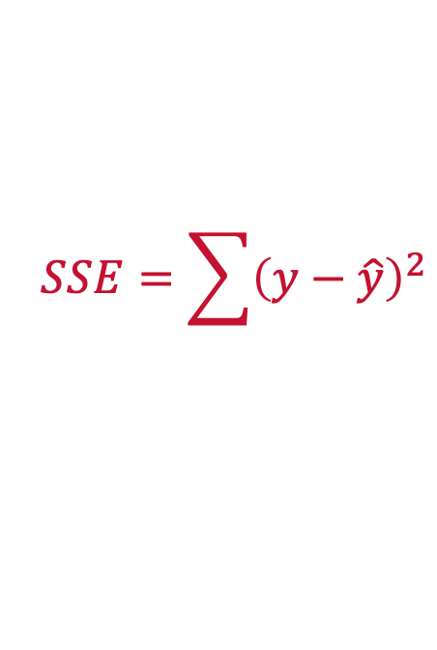
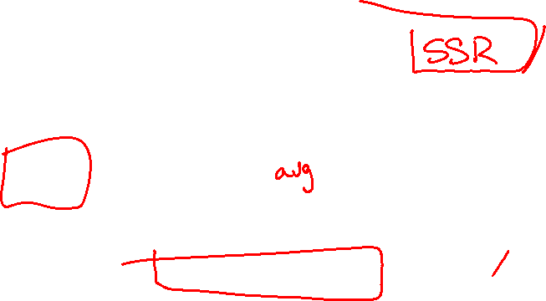
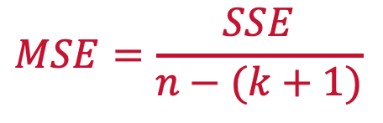

Unexplained Variation (SSE)
Sum of squares error (SSE)
Represents the errors made by the model
MSE can also be viewed as the average unexplained variation
$$SSE=\sum{{\left(y−\hat{y}\right)}^{2}}$$
$$MSE=\frac{SSE}{n−(k+1)}$$
Sq. Footage
Error degrees of freedom
House Age

Slide 29
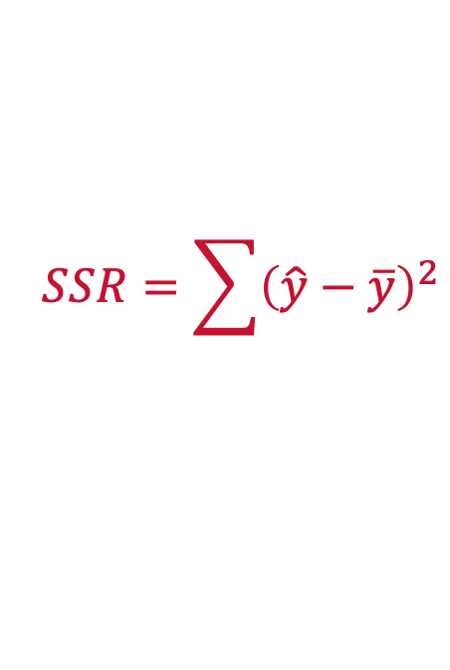
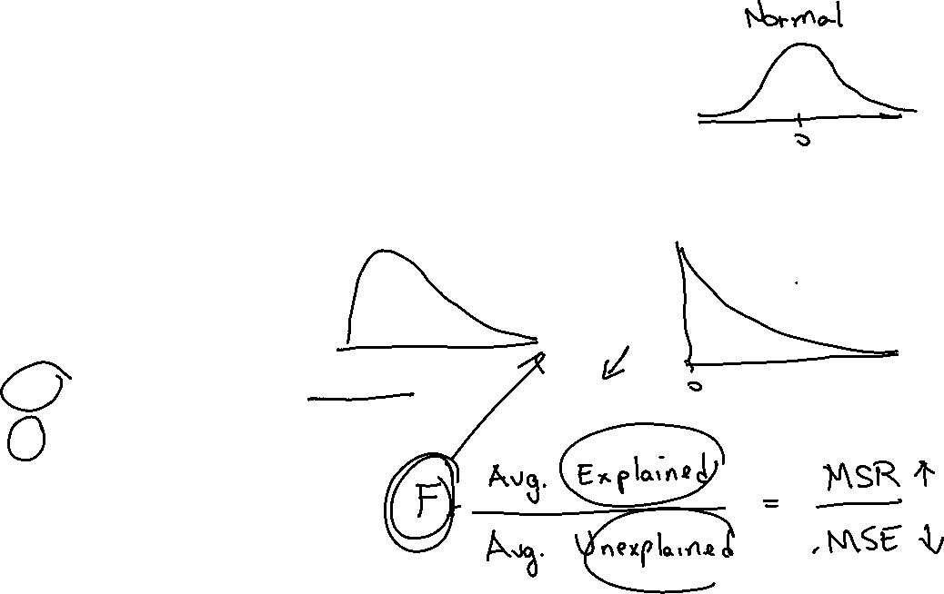

Total Explained Variation (SSR)
Sum of squares due to Regression (SSR)
Represents the amount of variation explained by the model
MSR can be thought of as the average explained variation
$$SSR=\sum{{\left(\hat{y}−\overline{y}\right)}^{2}}$$
Model degrees of freedom
$$MSR=\frac{SSR}{k}$$

Slide 30
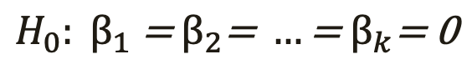
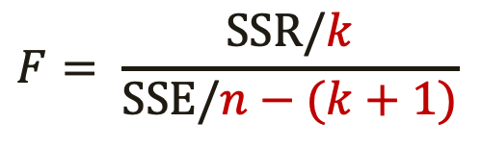
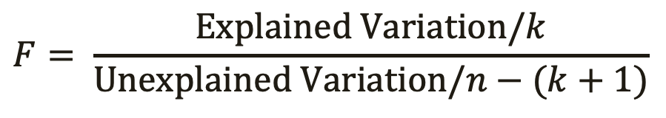
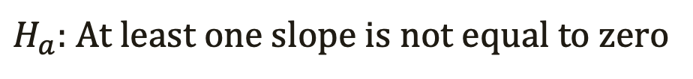
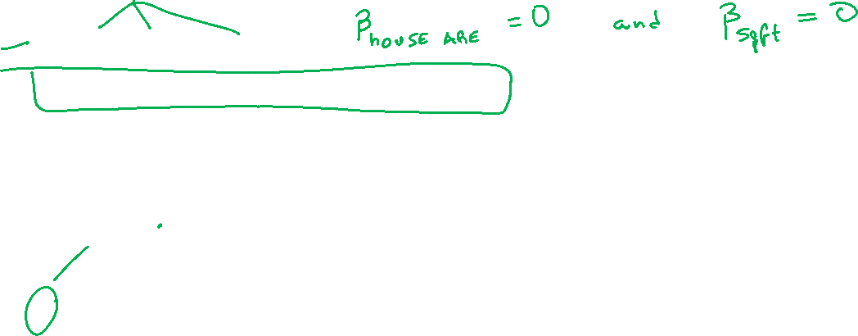
Overall Test of Significance
Hypothesis Test
Test Statistic
$$H_{0}: β_{1}\text{ = }β_{2}\text{= }…\text{= }β_{k}\text{= 0}$$
$H_{a}:$ At least one slope is not equal to zero
$$F= \frac{Explained Variation/k}{Unexplained Variation/n−(k+1)}$$
$$F= \frac{SSR/k}{SSE/n−(k+1)}$$
Numerator df
Denominator df

Slide 31

Practice

Slide 32
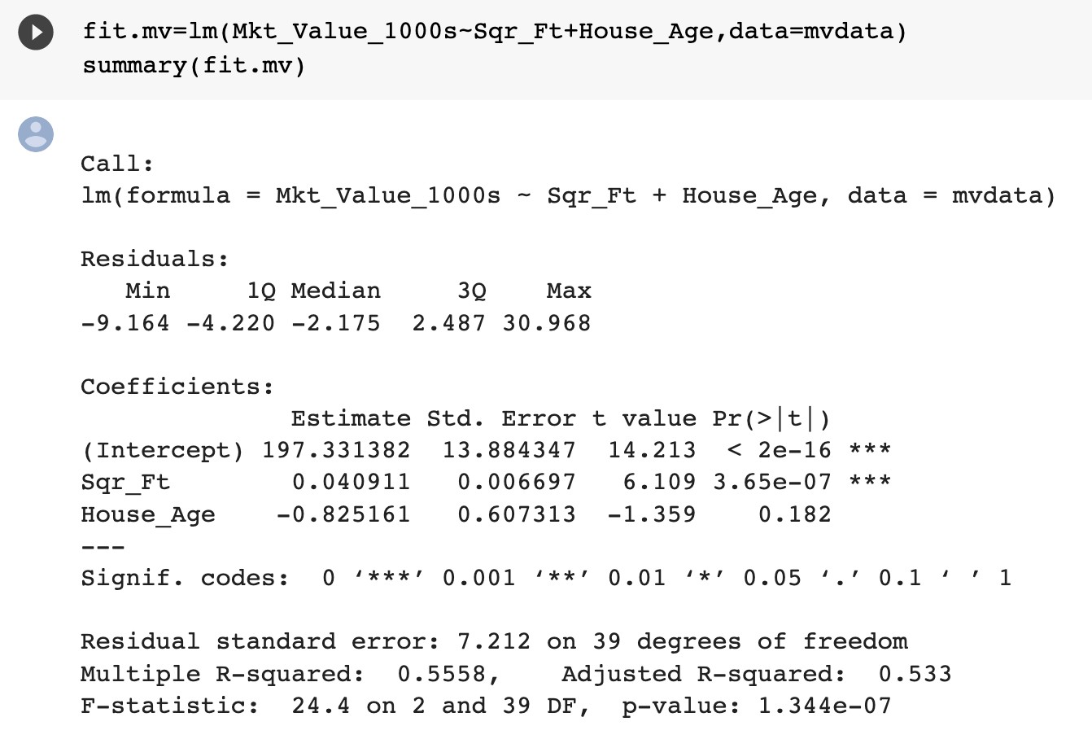
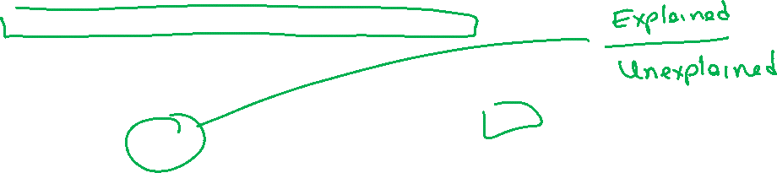
F-Statistic

Slide 33
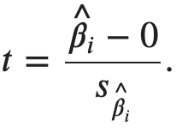
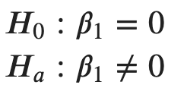
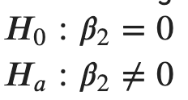
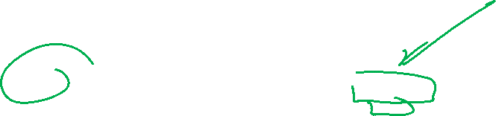
Partial Significance

Slide 34



Partial Tests
Each variable has its own partial test.
Partial significance means the variable is significant / insignificant given the other predictor(s) in the model.
$$H_{0}:β_{sqr_ft}=0$$
$$H_{a}:β_{sqr_ft}≠0$$

Slide 35



Partial Tests
Each variable has its own partial test.
$$H_{0}:β_{house_age}=0$$
$$H_{a}:β_{house_age}≠0$$

Slide 36
Practice

Slide 37

R² vs Adj-R²
Adding a predictor to multiple regression will always raise R²
The adj-R² is the preferred metric for explained variation

Slide 38
Practice

Slide 39



Confidence Intervals on Estimates
CIs on parameter are often helpful in determining significance

Slide 40
Practice

Slide 41



Linear Regression Assumptions
The mean of the probability distribution of $ε$ is 0.
The variance, $σ^{2}$ of the probability distribution of $ε$ is constant
The probability distribution of $ε$ is normal.
The errors associated are independent.
$$y=β_{0}+β_{1}x_{1}+β_{2}x_{2}+ε$$

Slide 42
Practice

Slide 43

Point Estimates
??????

Slide 44
Point Estimates
??????
House Age: 34 years
Square Footage: 2,064 sqft
Estimated Market Value: $253,716.3

Slide 45
Point Estimates
$$e=y−\hat{y}$$
Actual Market Value: $445,000
Estimated Market Value: $253,716.3

Slide 46
Practice

